Slide 1
Storage

Slide 2
Agenda
Glacier
DynamoDB
DynamoDB Partitions
DynamoDB GSI/LSI
DynamoDB Streams and Replication
DynamoDB Performance

Slide 3
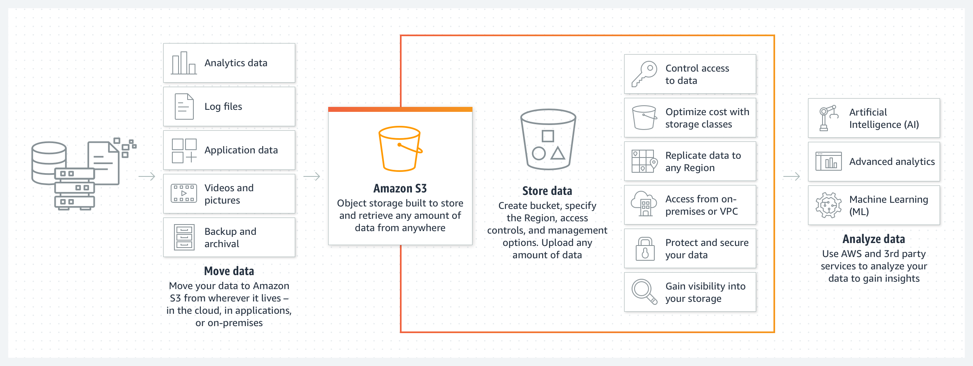
Glaciers
Amazon S3 Glacier storage classes are custom-made for better performance, data achieving, maximum data recovery flexibility, and lowest cost for storage.
Amazon Simple Storage Service (Amazon S3) is an object storage service from amazon
Amazon S3 provides high data scalability, availability, better performance an enhanced security.
Credit: https://aws.amazon.com/s3/storage-classes/glacier/
Notes:
Reference for contents : https://aws.amazon.com/s3/storage-classes/glacier/

Slide 4
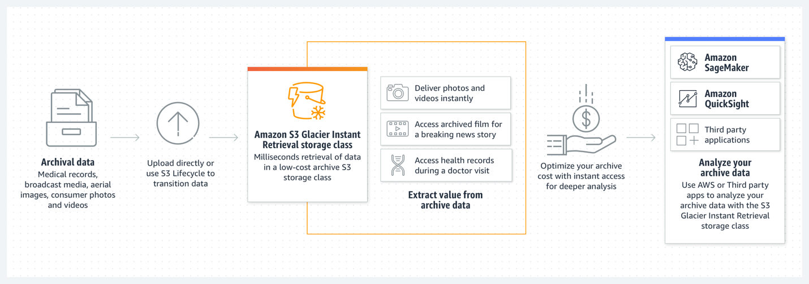
S3 Glacier Instant Retrieval storage class
Lowest cost storage for long living data
Designed for scarcely used data that sometimes needs immediate availability.
Characterised by high scalability and have 99.99% data durability.
Used in mage hosting, medical imaging and health records, news media assets etc
Credit: https://aws.amazon.com/s3/storage-classes/glacier/
Notes:
Reference for contents : https://aws.amazon.com/s3/storage-classes/glacier/

Slide 5
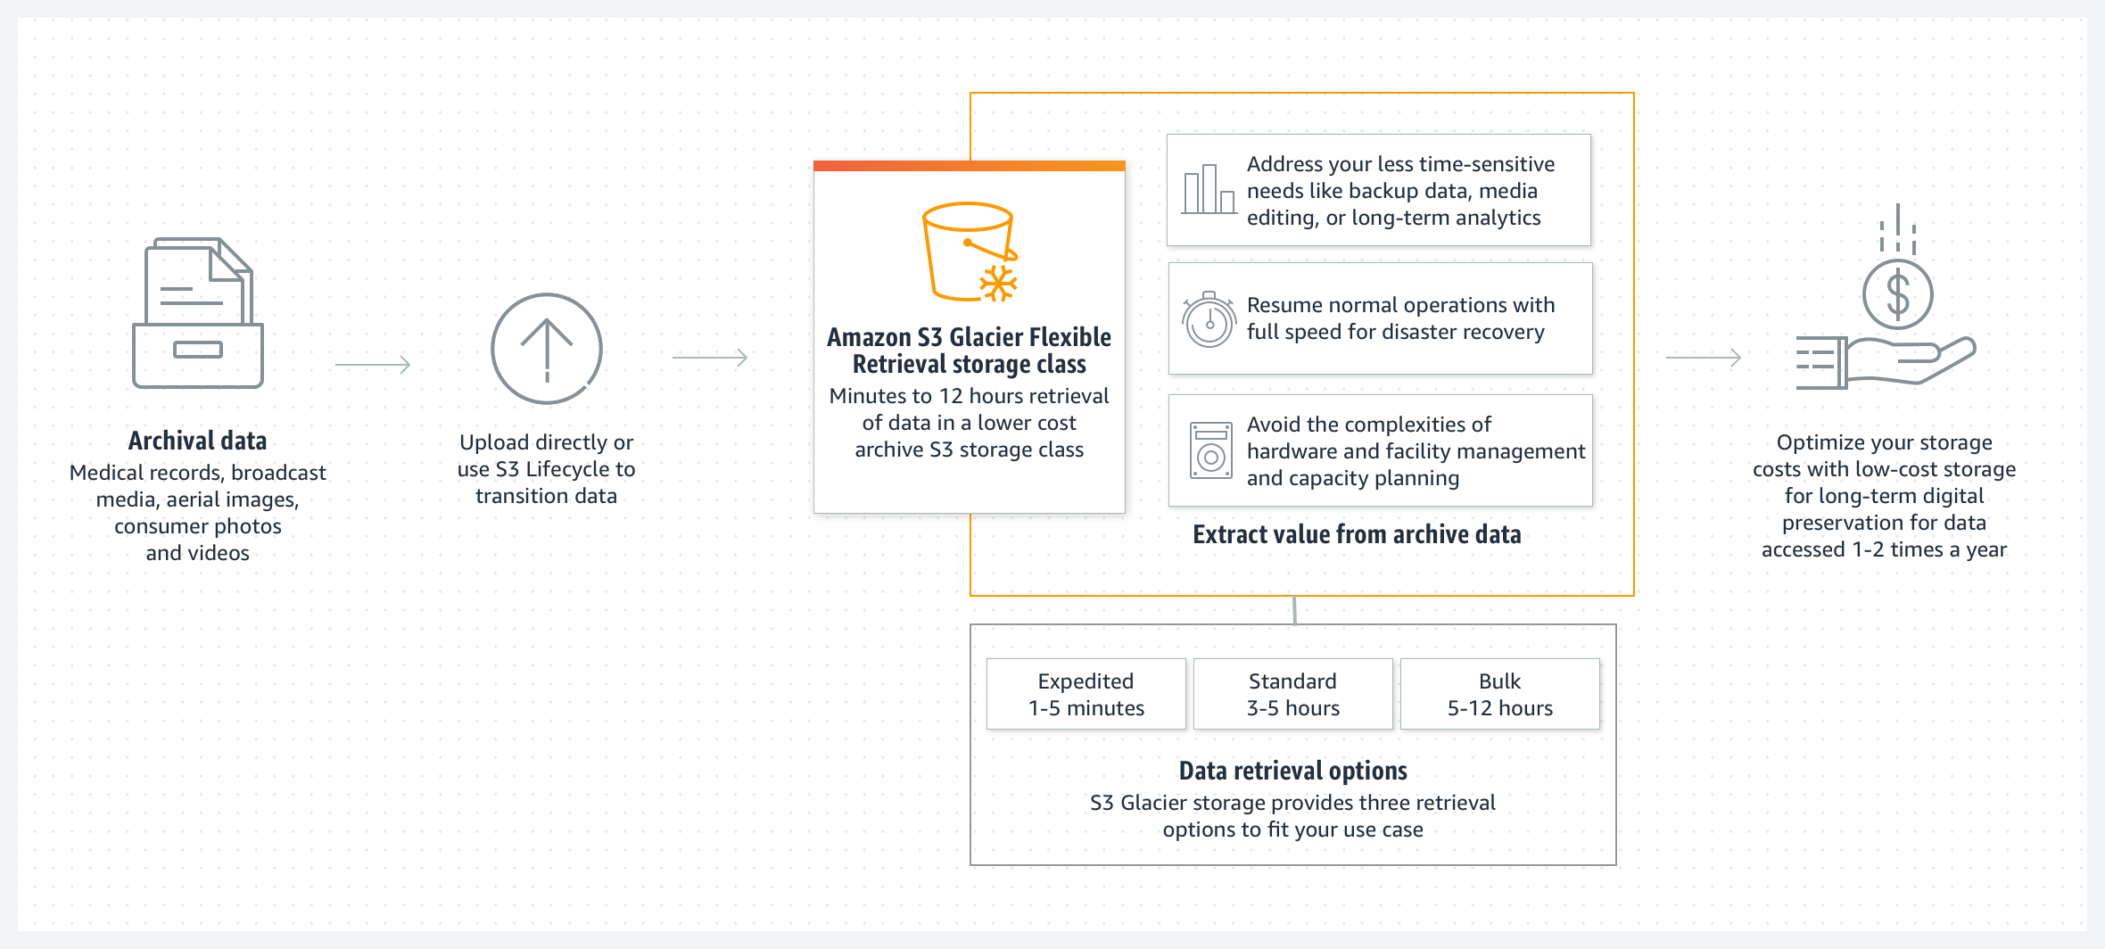
S3 Glacier Flexible Retrieval
Low-cost storage, up to 10% lower cost (than S3 Glacier Instant Retrieval).
Used for archiving data which is used 1-2 times a year and is retrieved asynchronously.
Best use case is for data which does not require immediate access but flexible to pull out large data set without cost.
Backup, disaster recovery, offsite data storage needs.
Credit: https://aws.amazon.com/s3/storage-classes/glacier/
Notes:
Reference for contents : https://aws.amazon.com/s3/storage-classes/glacier/

Slide 6
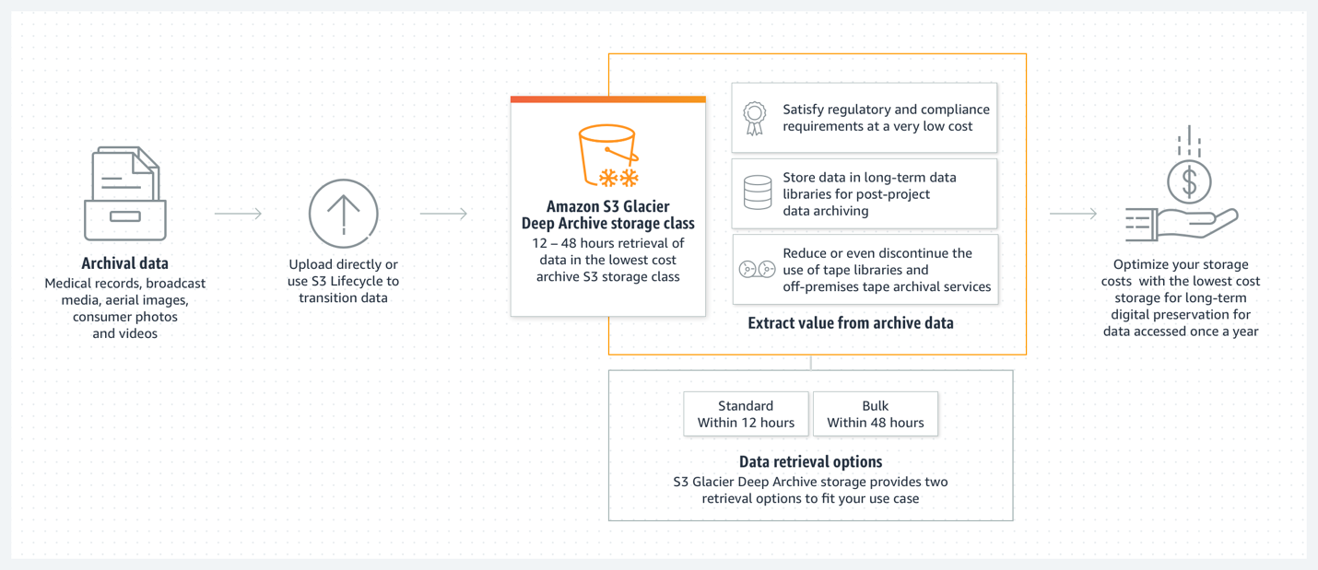
S3 Glacier Deep Archive
Delivers the lowest cost storage, up to 75% lower cost (than S3 Glacier)
long-lived archive data that is retrieved less than once a year and is called asynchronously.
Glacier Deep Archive is a replacement to tape as it is cost-effective and easily manageable.
Best used in financial services, healthcare, media and entertainment and public sector.
Credit: https://aws.amazon.com/s3/storage-classes/glacier/
Notes:
Reference for contents : https://aws.amazon.com/s3/storage-classes/glacier/

Slide 7
Features of glacier :
1.Quick and instant data retrievals
There are three retrieval options for S3 glacier flexible retrievals
1. Expedited retrievals completes in 1–5 minutes
2. Standard retrievals completes in 3–5 hours
3. Bulk retrievals completes in 5–12 hours.
There are two retrieval options for Amazon S3 Glacier Deep ranging from 12-48 hours.
2. Durability and scalability
It has boundless scalability with 99.99% data durability
Notes:
Reference for contents : https://aws.amazon.com/s3/storage-classes/glacier/

Slide 8
3.Cost effective
Customer need to pay only for services used.
S3 Glacier storage classes has customer friendly cost plans with a variety of services like data lakes, internet of things, Analytics.
4.Partner Support
Amazon S3 object storage services is used by many partners who have adapted their technologies to work with AWS for solutions such as back up, recovery and archiving.
5.Consistent data lifecycle
S3 Glacier storage classes are present in every AWS regions.
Locking of data from any region is available to avoid data deletions.
Notes:
Reference for contents : https://aws.amazon.com/s3/storage-classes/glacier/

Slide 9
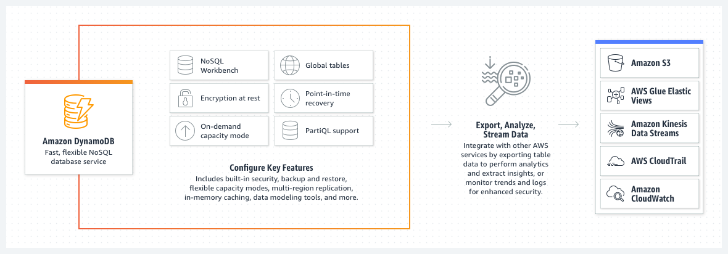
DynamoDB
Amazon DynamoDB is a NoSQL fully managed database service which can provides fast performance with adequate scalability.
DynamoDB has inbuild hardware provisioning, and configuration and replication.
DynamoDB provides encryption at rest which makes sure that the data stored in amazon cloud is protected.
DynamoDB allows users to create database tables that can store and retrieve large volume od data at any time and traffic.
Credit : https://d1.awsstatic.com/product-marketing/DynamoDB/product-page-diagram_Amazon-DynamoDB.a8a97936b804de5abb83fec9329acd03dec33332.png/
Notes:
Reference for the contents :https://aws.amazon.com/dynamodb/

Slide 10
It also provides high scalability and flexibility for its tables without effecting its performance.
Provide high scalability and flexibility for its tables without effecting its performance.
DynamoDB allows users to back up their data.
It can create full back up of the tables for long-time storage and also for daily retrievals.
Point in time recovery protects tables from accidental rewriting or deletion. This feature allows to restore a table altered within past 35 days.
DynamoDB provides provision to delete unused or unwanted data automatically from tables which will help to increase storage area.
Notes:
Reference for the contents :https://aws.amazon.com/dynamodb/

Slide 11
DynamoDB Availability and Durability
DynamoDB automatically extends the data and traffic for tables to a vast number of servers.
This helps to meet the storage requirement without effecting its consistency and the overall performance.
Data in AWS is stored in SSD’s which is then replicated across different zones in AWS region to maximise data availability and durability .
Global tables are used synchronise tables across different AWS regions.
The data in a table is automatically partitioned across numerous nodes using Dynamo DB, thus data throughput is not limited by the size of a single box.
Notes:
Reference for the contents :https://docs.aws.amazon.com/amazondynamodb/latest/developerguide/Introduction.html

Slide 12
Components of Dynamo DB
Tables are comparable to other data bases in that they are made up of rows and columns. Tables are used to store data in Dynamo DB.
Tables contain a distinct name as well as a key schema.
By choosing a number of reads and writes per second to support, you can reserve the required throughput.
Items —An item is a collection of properties that distinguishes it from all other items. There are zero or more items in each table.
Attributes - An attribute is a fundamental data element that does not require any more explanation. Each object is made up of a number of different attributes.
Notes:
https://docs.aws.amazon.com/amazondynamodb/latest/developerguide/HowItWorks.CoreComponents.html

Slide 13
Primary Key
Each item in the table is uniquely identified by the primary key, which means no two things can have the same key.
Two Types of primary key
Partition key- The partition key value cannot be the same for two objects.
Partition key and sort key- Multiple entries with the same partition key value are possible.
Secondary Index
Along with the queries for primary key, the secondary index allows querying the data in the database tables using an alternate key.
Notes:
https://docs.aws.amazon.com/amazondynamodb/latest/developerguide/HowItWorks.CoreComponents.html

Slide 14
Partitions and Data Distribution
Amazon DynamoDB stores data in partitions which is completely handled by itself.
A partition is an allocation of storage for the table, supported by solid state drives (SSDs).
Partitions are automatically copied and stored in different AWS regions which are available.
While table creation, initial status will be ‘creating’ .
DynamoDB assign enough partitions to the table during this phase as per the requirement.
When the status changes to Active reading and writing of the table can be performed.
Notes:
Reference for the contents: https://docs.aws.amazon.com/amazondynamodb/latest/developerguide/HowItWorks.Partitions.html

Slide 15
Additional partitions are provided by DynamoDB in the following cases
If the provision of table is beyond the existing supportable partition.
If the maximum capacity of partition is reached.
Partition management happens automatically in the background the table remains completely available throughout the partition.
Global secondary indexes in DynamoDB are also comprised of partitions but they are stored separately from data in table
There are three types of partitioning - Horizontal partitioning, Vertical partitioning and Functional partitioning.
Notes:
Reference for the contents: https://docs.aws.amazon.com/amazondynamodb/latest/developerguide/HowItWorks.Partitions.html

Slide 16
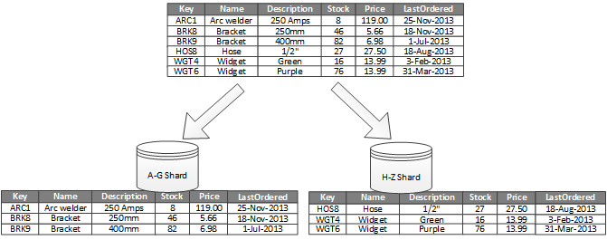
Horizontal partitioning
Also known as Sharding.
each partition act as separate data store, but have the same schema.
Each partition is called as a shard and detains a specific subset of the data.
such as all the orders for a specific set of customers.
Selection of sharding key is the most important part as it is responsible for distribution of workloads evenly.
Figure shows Horizontal partitioning of data based on partition key.
Credit:https://docs.aws.amazon.com/amazondynamodb/latest/developerguide/HowItWorks.Partitions.html/
Notes:
Reference for the contents: https://docs.aws.amazon.com/amazondynamodb/latest/developerguide/HowItWorks.Partitions.html

Slide 17
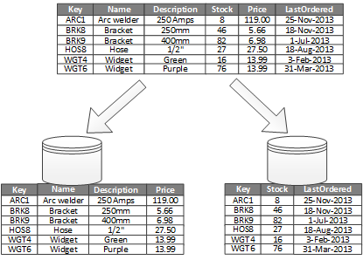
Vertical partitioning
Each partition holds a subset of the fields for items in the data store.
The fields are distributed on the basis of their use pattern
Vertical partitioning reduces the I/O and performance costs linked with frequently accessed data.
Best applicable for column-oriented data stores like HBase and Cassandra
Figure shows Vertically partitioning data by its pattern of use
Credit:https://docs.aws.amazon.com/amazondynamodb/latest/developerguide/HowItWorks.Partitions.html/

Slide 18
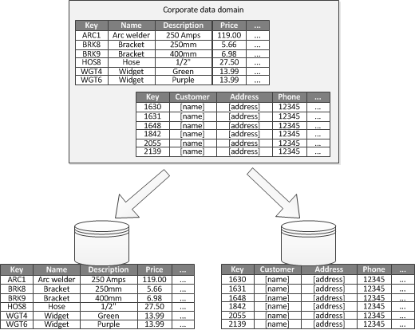
Functional partitioning.
Data is clustered based on its usage by bounded context.
This helps in improving isolation and the data access performance.
separating read-write data from read-only data is possible with this partitioning
This strategy reduces data access contention across various regions of a system
Figure provided - Functionally partitioning data by bounded context
Credit:https://docs.aws.amazon.com/amazondynamodb/latest/developerguide/HowItWorks.Partitions.html/
Notes:
Reference for the contents: https://docs.aws.amazon.com/amazondynamodb/latest/developerguide/HowItWorks.Partitions.html

Slide 19
Advantage of partitioning
Enhance scalability
Improve performance.
Enhance security.
Provide operational flexibility.
Match the data store to the pattern of use.
Improve availability.
Notes:
Reference for the contents: https://docs.aws.amazon.com/amazondynamodb/latest/developerguide/HowItWorks.Partitions.html

Slide 20
DynamoDB GSI/LSI
Dynamo DB uses primary key for faster access of data however certain application works better with secondary indexes.
A secondary index is a data structure which has the subset of attributes from the base table, together with an secondary key to support different operations.
Multiple secondary indexes are possible in the table for different fields
Each secondary index is associated with one base table and obtains data from it.
Amazon DynamoDB supports two types of secondary indexes:
Global secondary index and Local secondary index
Notes:
Reference for the contents : https://docs.aws.amazon.com/amazondynamodb/latest/developerguide/bp-indexes-general.html
Reference for the contents : https://docs.aws.amazon.com/amazondynamodb/latest/developerguide/SecondaryIndexes.html

Slide 21
Global secondary index
Global secondary index has its partition key and sort key which is different from the base table.
A global secondary index is global because queries on index can span all across the data in the base table and across different partitions.
For global secondary index there is no size margins.
GSI has its own provisioned throughput settings for activities such as read and write which may be separate from base tables.
Querying a global secondary index is similar to querying a local secondary index in that you use the Query or Scan procedures and supply the index name.
Notes:
Reference for the contents : https://docs.aws.amazon.com/amazondynamodb/latest/developerguide/bp-indexes-general.html

Slide 22
Local secondary index
Local secondary index has its partition key and base same but a different sort key
A local secondary index is called "local" in the sense that every partition of local secondary index is mapped to a base table partition that has same partition key value.
The maximum size for indexed item can’t exceed 10 GB in size.
local secondary index shares provisioned throughput settings for read as well as write activity with the table it is indexing.
The local secondary index enables Query to obtain several items with the same partition key value but various sort key values, as well as one item with a given partition key value and sort key value.
Notes:
Reference for the contents : https://docs.aws.amazon.com/amazondynamodb/latest/developerguide/bp-indexes-general.html

Slide 23
Comparison GSI and LSI
Key Schema
GSI- primary key can be simple or composite
LSI –primary key must be composite
Key attributes
GSI-index partition key and sort key can be from any base table
LSI- attribute of index partition key should be same as that of base table. Sort key can be different
Size restriction per partition key
GSI – No size restriction
LSI-should be 10 GB or lesser
Notes:
https://docs.aws.amazon.com/amazondynamodb/latest/developerguide/SecondaryIndexes.html

Slide 24
Online Index Operations
GSI-can be added and deleted ti an existing table
LSI-cannot be done to an existing table
Queries and Partitions
GSI-Allows to query over entire table and partitions
LSI-allows to query over a key specified single partition
Read Consistency
GSI –supports eventual consistency only
LSI- eventual consistency or strong consistency.
Notes:
Reference for the contents : https://docs.aws.amazon.com/amazondynamodb/latest/developerguide/bp-indexes-general.html

Slide 25
Provisioned Throughput Consumption
GSI- has provisioned settings for read and write
LSI – Consumes read /write capacity units from base table
Projected Attributes
GSI –does not fetches any attribute
LSI- Automatically fetches attributes
Default indexes
GSI- 20 global secondary indexes for every table
LSI - 5 local secondary indexes for every table
Notes:
Reference for the contents : https://docs.aws.amazon.com/amazondynamodb/latest/developerguide/bp-indexes-general.html

Slide 26
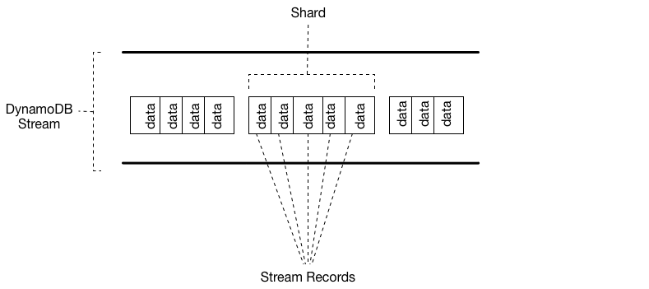
DynamoDB Streams and Replication
An organised flow of data about changes to content in a DynamoDB table is termed as DynamoDB stream.
It can store information up 24 hours
Applications can access the information in DynamoDB streams to identify the changes before and after the modifications.
Figure shows the relation between stream, shard and stream record.
Credits:https://docs.aws.amazon.com/amazondynamodb/latest/developerguide/Streams.html/
Notes:
Reference for contents :https://docs.aws.amazon.com/amazondynamodb/latest/developerguide/Streams.html

Slide 27
Data is encrypted at rest in DynamoDB streams.
When you enable a stream on a table, DynamoDB captures information about every modification to data items in the table.
DynamoDB streams enters a stream record when an application create ,update or delete any entries in the table along with the primary key attributes of the same.
Stream record includes information about the data modification on a single item in the DynamoDB table.
DynamoDB streams can be customised to include additional data such as before and after images etc.
Notes:
Reference for contents :https://docs.aws.amazon.com/amazondynamodb/latest/developerguide/Streams.html

Slide 28
AWS maintains separate endpoints for DynamoDB and DynamoDB Streams
DynamoDB Streams guarantees that :
Each stream record will be present only once in stream.
The stream records will be seen in the same order as the actual modifications to the item in the DynamoDB table.
DynamoDB Streams provides real time stream data which will help building applications that run in real time.
The data in the stream will be available to read for 24 hours after this the stream data will be automatically deleted.
Notes:
Reference for contents : https://docs.aws.amazon.com/amazondynamodb/latest/developerguide/Streams.html

Slide 29
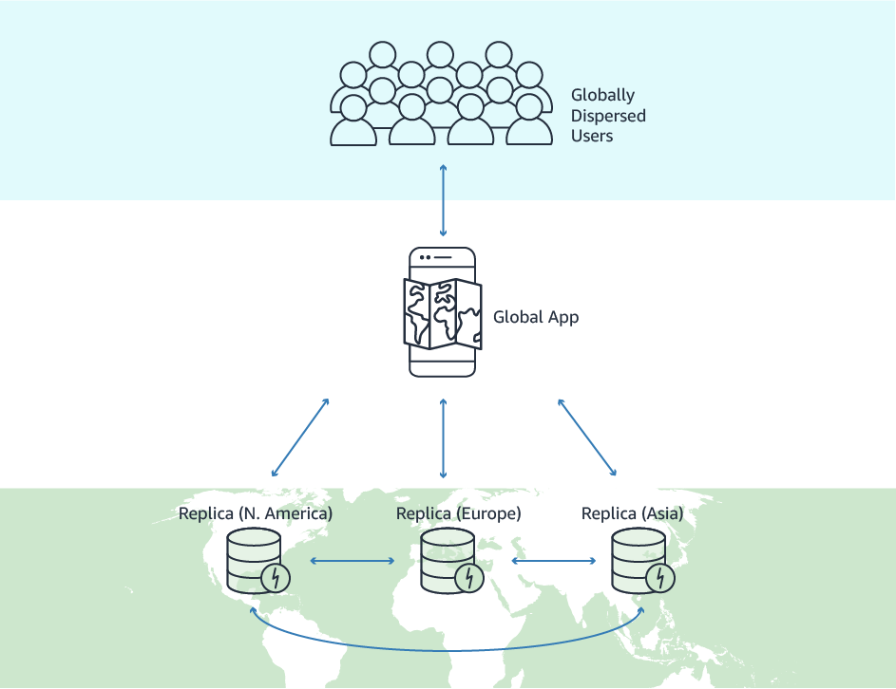
DynamoDB Replication
Amazon DynamoDB provides cross-region replication where it can automatically replicate tables across different AWS regions.
This will create a global platform with low latency, better management and easy data migration.
No additional charge for using the cross-region replication application. Payment only for other AWS resources used for replication
Credits : https://aws.amazon.com/dynamodb/global-tables/
Notes:
Reference for contents : https://aws.amazon.com/about-aws/whats-new/2015/07/amazon-dynamodb-available-now-cross-region-replication-triggers-and-streams/

Slide 30
Amazon DynamoDB global tables provide a fully managed solution for deploying a multi-region, multi-active database, without having to build and maintain your own replication solution.
Amazon DynamoDB global tables which is completely managed scheme for multi region databases without the need of customer maintain the replication.
Global tables can be created anywhere in the AWS region.
All the tasks are internally done by AWS.
If replicas of different AWS regions are having different access patterns, different table class is used by each replica to optimize cost and performance.
Notes:
Reference for contents : https://aws.amazon.com/about-aws/whats-new/2015/07/amazon-dynamodb-available-now-cross-region-replication-triggers-and-streams/

Slide 31
DynamoDB global tables are best choice for highly scaled applications with worldwide users.
Automatic multi-active replication is the key feature of global tables.
Data replication happens in multiple nodes
The coordinator node is responsible for the read write operation of the key corresponding to different task.
The list of nodes in charge of storing a certain key is called preference list.
DynamoDB has a default replication factor of 3
Notes:
Reference for contents : https://aws.amazon.com/about-aws/whats-new/2015/07/amazon-dynamodb-available-now-cross-region-replication-triggers-and-streams/

Slide 32
DynamoDB Performance
As per the user requirement DynamoDB can scale its size horizontally.
Runs exclusively on Solid State Drives (SSDs).
It works on Solid state servers which will help to fulfil the target in lesser time due to its low latency response time
It can scale tables which are used to read and write whenever the customer requires.
Whenever the table size grows beyond expectation or if the provisioned throughput gets increased DynamoDB automatically created partitions, repartition the data to improve server capacity.
Notes:
Reference for the content : https://jayendrapatil.com/tag/dynamodb-performance/

Slide 33
Improving DynamoDB performance
Always go for eventually consistent reads if you don't need very consistent reads.
By parallelizing reads and writes over numerous partitions, you can enhance your DynamoDB throughput by several times.
Instead of using DynamoDB as a document store, use it as an attribute store.This will not only lower your read/write charges, but it will also significantly increase the performance of your processes.
To parallelize requests to DynamoDB, use batching whenever possible.
Wherever practical, consider using query operations in conjunction with indexes as an option.
Notes:
Reference for the content : https://docs.aws.amazon.com/amazondynamodb/latest/developerguide/best-practices.html

